Slide 1
Introductions
City of San Carlos Team Introductions
Lisa Porras, Planning Manager
Sajuti Haque, Management Analyst
Sara Cadona, Assistant Planner
Josh Abrams, Baird + Driskell, 21 Elements
Who is Joining Us?
Chat your name and something you love about our community
www.SanCarlos2040.org

Slide 2
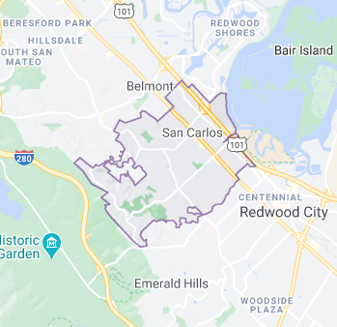
What’s Our Context?
San Carlos: Who Lives Here?
Population: 28,406 (2010)
30,185 (2019)
Source: U.S. Census (2010 and 2019 data)
Total Households: 11,327
Average Household Size: 2.68
Source: U.S. Census (2010)
Notes:
Your city intro can be anywhere 5-15 minutes and include any of the following you think will be important:
City-specific demographics, fun facts, housing trends
Existing long-range, specific planning, results of latest efforts

Slide 3
Existing Land Use
Planning Area Existing Land Use | Acres | % of Total
Single Family Residential | 1,799 | 50.4
Multifamily Residential | 168 | 4.7
Mixed Use | 8 | <1
Commercial | 226 | 6.3
Industrial | 264 | 7.4
Pub. Facilities | 306 | 8.6
Parks/Open Space | 647 | 18.1
Parking | 20 | <1
Vacant | 133 | 3.7

Slide 4
What’s Our Context?
San Carlos: Who Lives Here? (Age)
0-19: 7,754 (26%)
20-44: 8,522 (28%)
45-64: 9,146 (30%)
65+: 4,658 (16%)
Median Age: 42.2
Notes:
Your city intro can be anywhere 5-15 minutes and include any of the following you think will be important:
City-specific demographics, fun facts, housing trends
Existing long-range, specific planning, results of latest efforts

Slide 5
What’s Our Context?
San Carlos : Rates of Home Ownership and Rental
Own: 8,148 (72%)
Rent: 3,179 (28%)
Notes:
Your city intro can be anywhere 5-15 minutes and include any of the following you think will be important:
City-specific demographics, fun facts, housing trends
Existing long-range, specific planning, results of latest efforts

Slide 6
What’s Our Context?
San Carlos: Housing Stock
72% of San Carlos’ existing Housing Stock consists of Single-Family Residences
Source: 2020 CA Department of Finance E-5 Population and Housing Estimates, US Census Bureau 2018 5-Year Estimates, CoreLogic August 2020)
Notes:
Your city intro can be anywhere 5-15 minutes and include any of the following you think will be important:
City-specific demographics, fun facts, housing trends
Existing long-range, specific planning, results of latest efforts

Slide 7
Our Housing Element
Progress in Meeting Our RHNA Targets for Cycle 5
Income Level | RHNA 5 Allocation | Permits Issued | Remaining Permits to be Issued
Very Low Income (50% AMI) | 195 | 22 | 173
Low Income (60% AMI) | 107 | 14 | 93
Moderate Income (80% AMI) | 111 | 13 | 98
Above Moderate Income (120% AMI) | 183 | 526 | 0
TOTAL: | 596 | 575 | 364

Slide 8
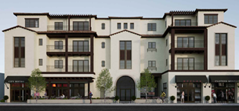
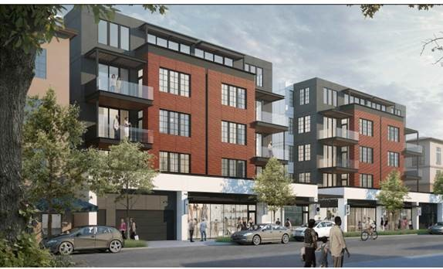
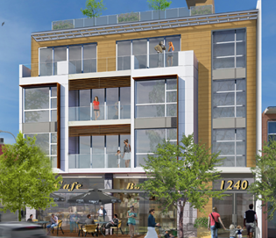
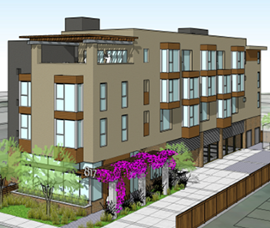
Our Housing Element
RHNA Cycle 5 - Accomplishments
Since 2015, San Carlos issued permits to construct 575 new units.
In 2020, 39 Accessory Dwelling Units were approved.
In 2020, San Carlos issued a building permit to construct 23 very-low income units at 817 Walnut Street.
1240 El Camino Real; 8 condos (1 mod)
817 Walnut; 24 rental units (23 very low)
560 El Camino Real; 24 condos (1 mod; 1 low)
626 Walnut; 35 condos (1 mod; 3 low)
Notes:
Programs, policies, projects accomplished this cycle
Key concerns, constraints, issues brought up by the community, issues carried over from the last update

Slide 9
What’s Our Context?
San Carlos Policy Actions
Commercial Linkage Fee: Effective March 16, 2017 San Carlos established a commercial development to fund affordable housing.
Citywide: San Carlos amended its ADU Ordinance to comply with new State law, effective November 2020.
Inclusionary (Below Market Rate Housing) Ordinance: In 2021, San Carlos will be updating its affordable housing ordinance to boost affordable housing production.
Notes:
Your city intro can be anywhere 5-15 minutes and include any of the following you think will be important:
City-specific demographics, fun facts, housing trends
Existing long-range, specific planning, results of latest efforts

Slide 10
Our Housing Element
Our RHNA Target* Increases for Cycle 6
Income Level | RHNA 5 Allocation | RHNA 6 Allocation | Increase
Very Low Income (50% AMI) | 195 | 739 | 544 units
Low Income (60% AMI) | 107 | 425 | 318 units
Moderate Income (80% AMI) | 111 | 438 | 327 units
Above Moderate Income (120% AMI) | 183 | 1133 | 950 units
TOTAL: | 596 | 2,735 | 2,139 units (4.58 x increase)
* (not a construction obligation)

Slide 11
Our Housing Element
What we’ve heard so far...
Access to transit; multi-modal transportation; walkability
Aesthetics (high quality, well-designed)
Density (impacts to traffic congestion); increase densities
Greenhouse gas emissions (do not use gas fueled furnaces, water heaters, stoves; solar)
Housing for seniors; assisted living facilities
Implications of single-family zoning (perpetuating inequities)
Impacts to infrastructure (e.g. wastewater facilties)
Needs for open space
Schools; accommodating growth
Avoid sprawl; higher densities in strategic locations
Wildfires; concerns with added development in the hills (also underground utilities)
Variety of housing options
Mixed use; intersperse retail within residential zones

Slide 12
Our Timeline
Meetings, Workshops and Surveys to Receive Input
Identify Potential Land Use Changes/Housing Sites and Identify Hazard Risk Areas/Solutions
Draft Elements and Zoning Amendments
Public Input
State HCD, Mines/Geology, and CALFIRE Review
Environmental Analysis
Planning Commission and City Council Consideration
Fall 2020
Winter 2021
Summer 2021
Fall 2021
Winter 2021/2022
Summer 2022
Public Input

Slide 13
Questions?

Slide 14
Let’s Hear From You

Slide 15
Agreements / Ground Rules
No right or wrong answers
Share the space
Respect confidentiality (share learnings; don’t attribute without permission)
No interruptions or other disrespect
Equal chance to speak

Slide 16
What is working in San Carlos?
What are some of our key housing needs, challenges or opportunities?
What ideas, policies, programs, suggestions do you have to meet our housing needs?
How can we make sure we hear from our entire community?
5. It’s 2030, and we accomplished a lot! What words describe the housing in our community now?
Notes:
Open Mural link
Questions:
In regards to housing, what is working in our jurisdictions? What do you think makes us special?
What are some of our key housing needs or challenges?
What ideas, policies, programs, suggestions do you have to meet our housing needs?
How can we make sure we hear from our entire community?
It’s 2030, it was a damn good housing element and we accomplished a lot! What words describe the housing in our community now?

Slide 17
What’s Next
Upcoming Events
June – workshop (date TBD)
21 Elements will be hosting additional workshops throughout Summer/Fall 2021
Contact Us
Lisa Porras, Planning Manager
lporras@cityofsancarlos.org
Email Sara Cadona, Assistant Planner – Join our mailing list!
scadona@cityofsancarlos.org
www.SanCarlos2040.org

